Slide 1


Optimization of Roof Greening Spatial Planning to Cool Down the Summer of the City
ESPM MPhil 1st Year Ruby Qinru ZHUANG
Supervisor: Zhongming Lu

Slide 2
Table of Content
01. Background
02. Research Questions
03. Methodology
04. Results
05. Discussion
Notes:
And this is the outline of my content

Slide 3
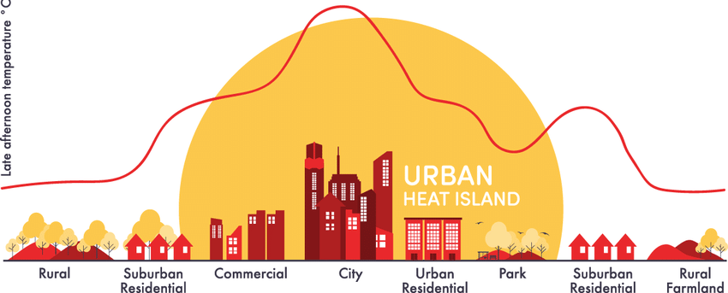




01. Background —— Urban Heat Island
From 1998 – 2017,
> 166 000 mortality due to heatwaves.
> 70 000 died during the 2003 heatwave in Europe.
Day: 3 °C
Night: 12 °C
Source: USEPA, WHO
Notes:
It refers to the higher temperature in the metropolitan area than the surrounding suburban area resulting from the thermal properties of materials used in urban areas (e.g. concrete, asphalt), which store more heat, and the reduction of the cooling effect of vegetation.
The annual mean air temperature of a city with 1 million people–3.0 °C warmer than its surroundings. In the evening, the difference can be as high as 12 °C
Such high temperature can persists for long and induce more diseases.
According to WHO
Not to mention other harms, including the increase of air pollution, (trap and promote synthesis), rise of energy use, causing discomfort to citizens

Slide 4
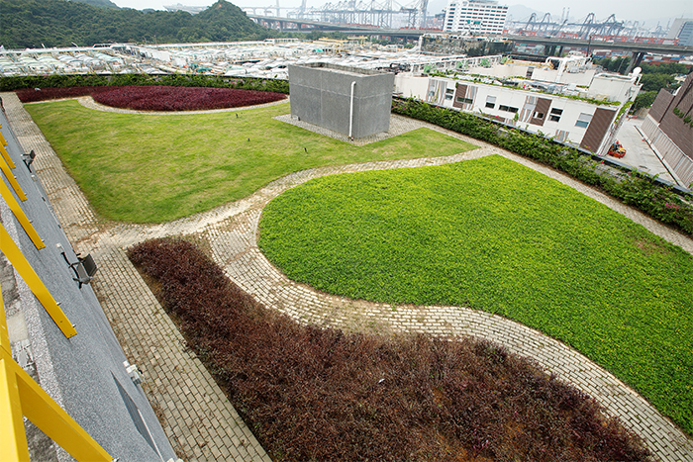
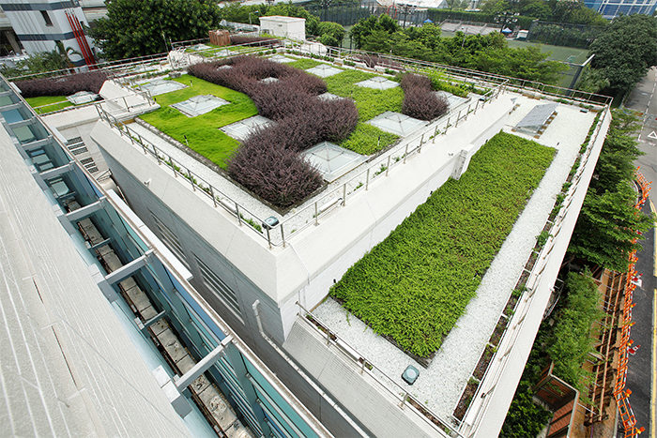
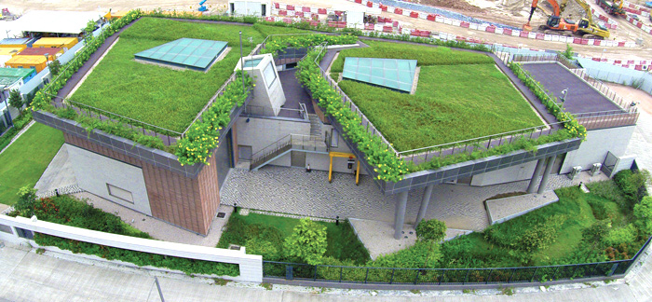
01. Background —— Green Roof
Urban Green Infrastructure
Green alley/green park
Street plantings
Rain garden
Green roof
Require less open area
Provide insulation to the building
Increase evapotranspiration
Source: DSD
Notes:
To mitigate UHI, an effective way is to increase the urban vegetation by implementing GI, such as
Among which, green roof has below highlights, e.g. making it more suitable for cities facing land shortage, it also increase large area of evapotranspiration compared with concrete roof
On the right are some examples of green roof in HK. Green roof is a focus of GI development for HK government.

Slide 5
01. Background —— Green Roof
Regional Climate Model
+
Urban Canopy Model
↓
Mitigation Effect in Cities
Planning evaluation in cities & Optimization
Microclimate Model
↓
Planning Evaluation in Blocks
Source: DSD
Notes:
In current green roof studies, there are mainly two directions. First is to use regional climate model such
To simulate the . Such studies can show how 100% green roof implementation change the heat flux, evapotranspiration and the whole city climate
Green roof studies are also carried out in a block scale using microclimate model such as ENVI-Met, which are capable to evaluate the effect of various plannings with different gi and patterns to assist real project application.
What we are thinking is that to evaluate different plannnings of green roof and find the optimized pattern in city scale instead of community so as to provide reference for planners in in urban renewal

Slide 6
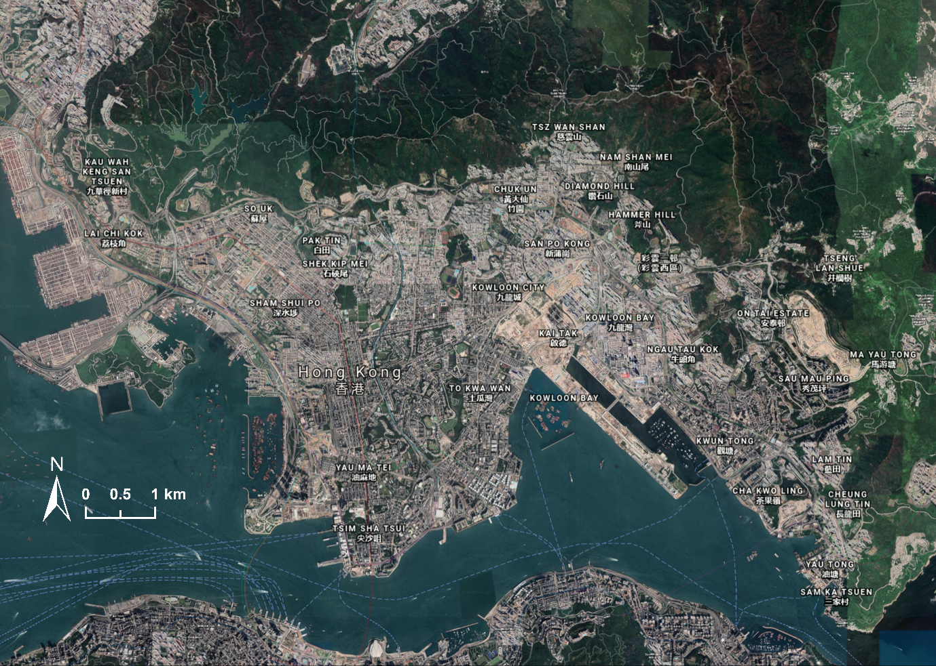
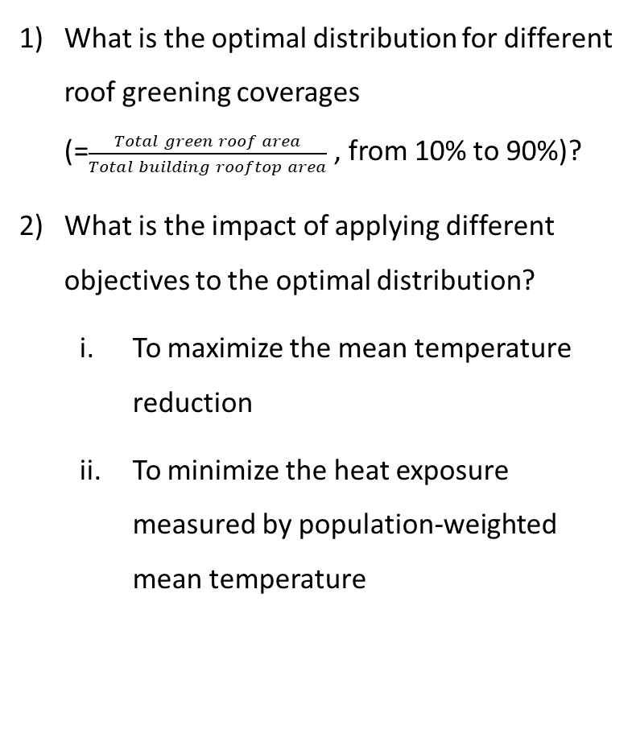
02. Research Questions
What is the optimal distribution for different roof greening coverages (=$\frac{Total green roof area}{Total building rooftop area}$ , from 10% to 90%)?
What is the impact of applying different objectives to the optimal distribution?
  To maximize the mean temperature reduction
  To minimize the heat exposure measured by population-weighted mean temperature
Figure 1: Study area – Kowloon, Hong Kong
Notes:
Our study area is Kowloon HK, the densest urban area in Hong Kong with one-third of its entire population
Research questions include

Slide 7
03. Methodology —— Urban Cooling Model
The InVEST Urban Cooling Model (UCM)
The UCM model is developed by the Natural Capital Project to simulate the urban temperature with reference to rural temperature. It is mainly based on static geographical data to estimate the temperature reduction by vegetation to UHI.
Calibration of the coefficients
Biophysical parameters
Shading
Evapotranspiration
Albedo
Reference Temperature
…
Land Use Data
Heat mitigation index calculation
It can provide a simplified approach to evaluate the master plans based on the LULC maps of diverse synthetic scenarios.
Notes:
The models we used include two parts. One is to simulate urban temperature, another is to do optimization. We use UCM developed by
Unlike other traditional popular climate models, it is , so it more focused on the relationship of temperature and vegetation, land use.
The main input is land use data and the corresponding biop including,
Then it calculate the heat ,which include some linear coefficients adjustable according to local conditions, which will be calibrated to tailor Hk
The hightlight of this model is that which making it possible for us to do many runs of optimizations.

Slide 8
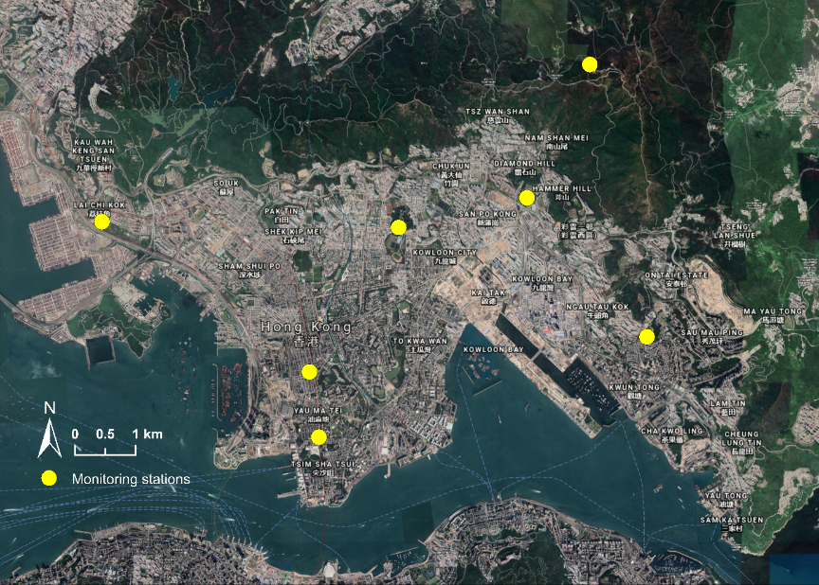
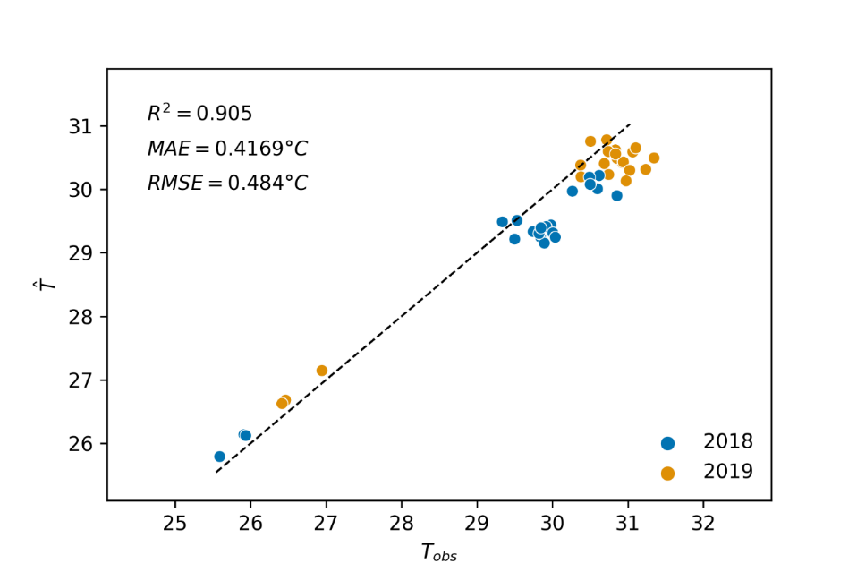
03. Methodology —— Calibration
Simulated Annealing Method
Simulated annealing (SA) is a probabilistic technique for approximating the global optimum of a given function. The calibration minimizes (1-R²) in each annealing, where R² is the coefficient of determination between the observed and predicted temperatures.
Figure 2: Locations of HKO monitoring stations
Figure 3: Scatterplot of the temperatures predicted by UCM against observed temperatures in Kowloon: 2019 summer for calibration and 2018 summer for validation.
Notes:
For the calibraion of model, simulated annealing method is adopted, which is capable to find global optimum of the coefficients. For the data, we used the average temperature data of 2pm in June, July, August in 2019 collected from the 7 HKO Meteorology stations to calibrate a set of parameters that is suitable for the hottest hour in summer of Kowloon. Similar data from 2018 is used for validation and the result is shown in the graph.

Slide 9
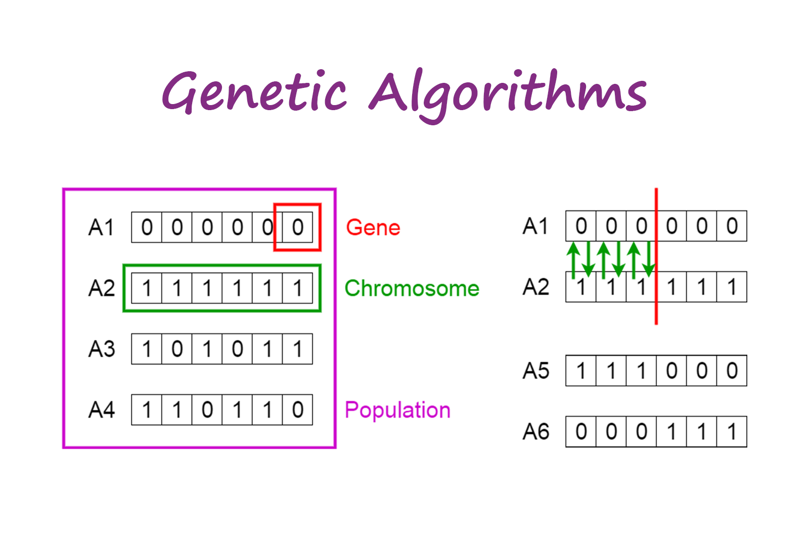
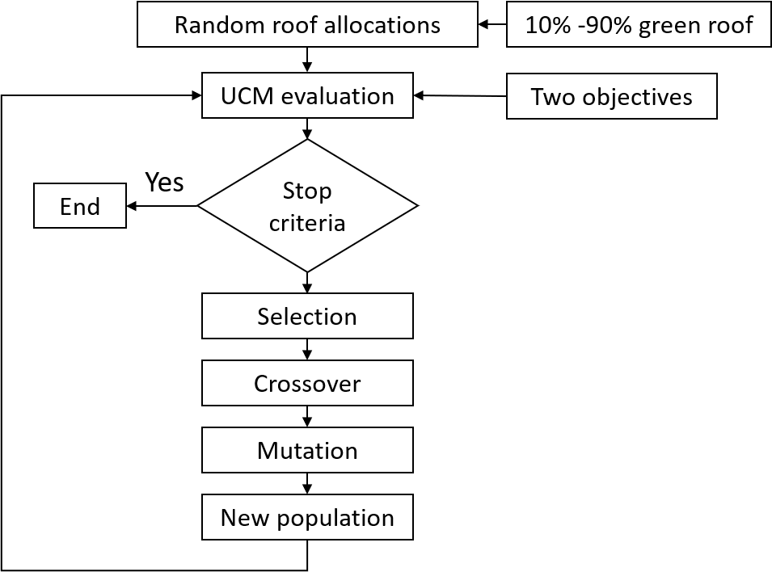
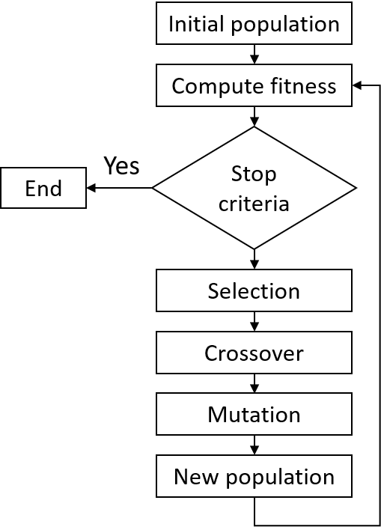
03. Methodology —— Optimization
Genetic Algorithm
Genetic Algorithms (GAs) are metaheuristic algorithms based on the concepts of natural selection and genetics proposed by Darwin.
Gene ∈ Individual ∈ Population
Offspring
Offspring
Notes:
After the UCM is set, optimization is conducted using GA. Similar to the gene theory, An individual consists of a sequence of variables called genes. And individuals make up a population. the population goes through genetic variation processes including crossover and mutation, the offspring with new genes are generated, in which better individuals are selected to form the next generation. The evolution process keeps repeating until it meet the stopping criteria.
As we want to test under different green roof coverage and different objectives, what is the optimization pattern. So in total there will be 18 rounds of optimizaitons.
The initial population for each round will be random roof allocations, and then after ucm calculating temperature, after generations of selection, the solutions gradually converges to a optimized pattern.

Slide 10
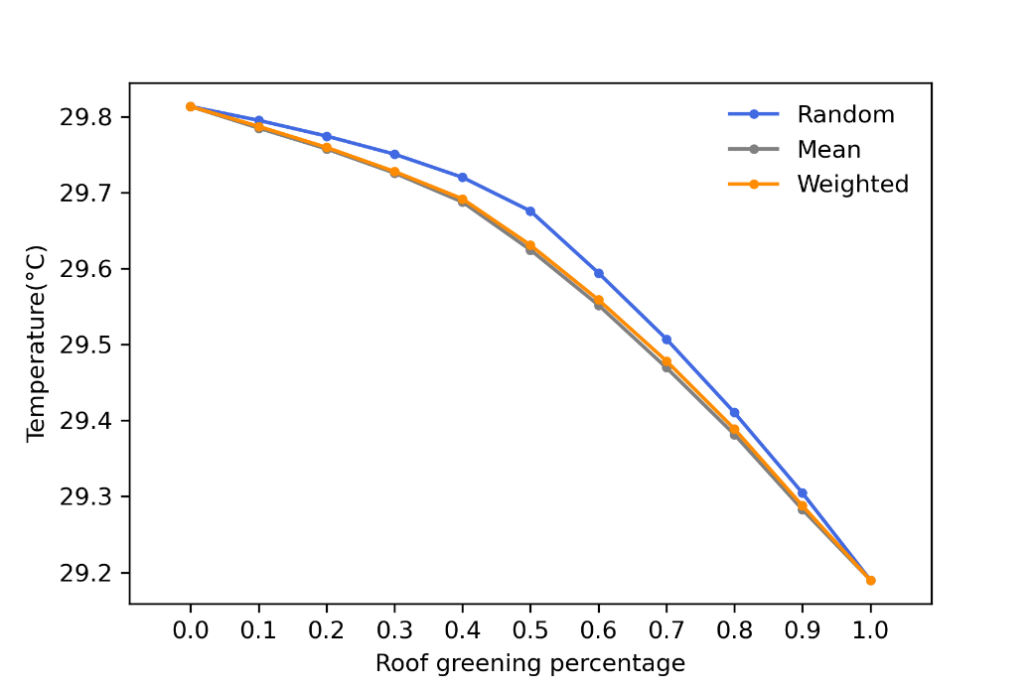
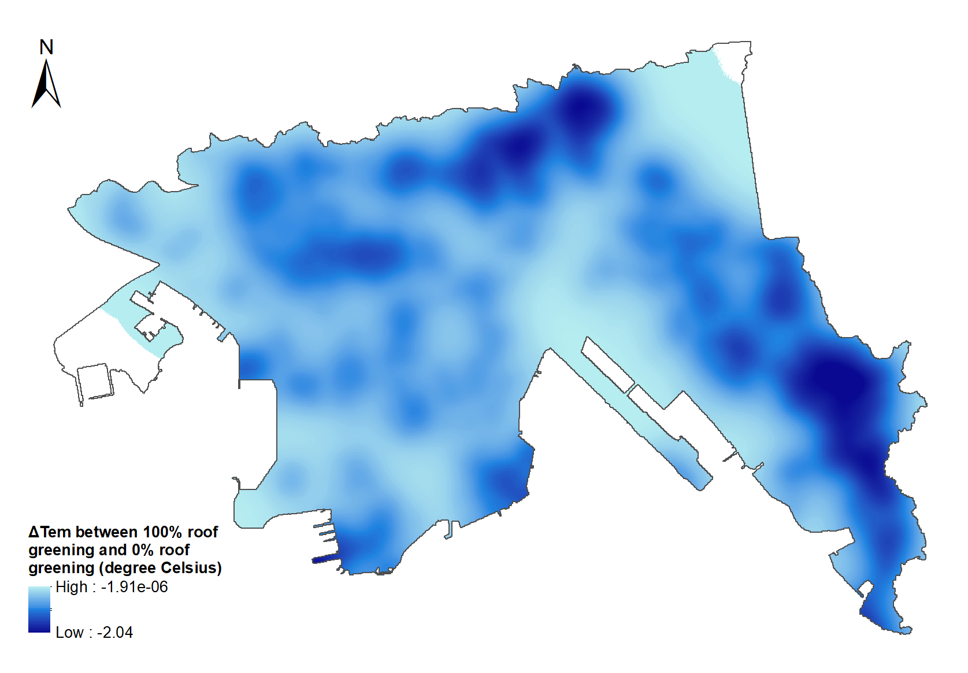
04. Result —— Overall Cooling Effects
With 100% green roof, the mean air temperature decreases by 0.62℃.
Optimization has more prominent effect for roof greening ranging from 30% and 70%.
Marginal reduction of mean air temperature is larger for roof greening coverage over 40%.
Figure 4. Temperature reduction resulting from 100% roof greening coverage compared with the baseline of zero coverage.
Figure 5. The change of mean air temperatures along with the percentages of roof greening coverage: to maxmize the mean air temperature reduction (grey line); to minimize the heat exposure (orange line); and the randomly distributed roof greening (blue line).
Notes:
For the results, with 100% green roof, the, and the largest temperature reduction can reach 2.04 ℃
From the mean temperature figure on the right, blue line represents no optimization/random green roof allocation, grey line is the op with objective to minimize physical mean temperature, orange line is to minimize heat exposure
First we can see when the coverage ranges from 30 -70, the temperature difference of applying optimization is more significant.
After 40%, the reduction line becomes steeper, indicating the marginal reduction after 40% is larger.
For the two objectives, minimize does not make much difference with in terms of temperature. But their geographical patterns do differ.

Slide 11
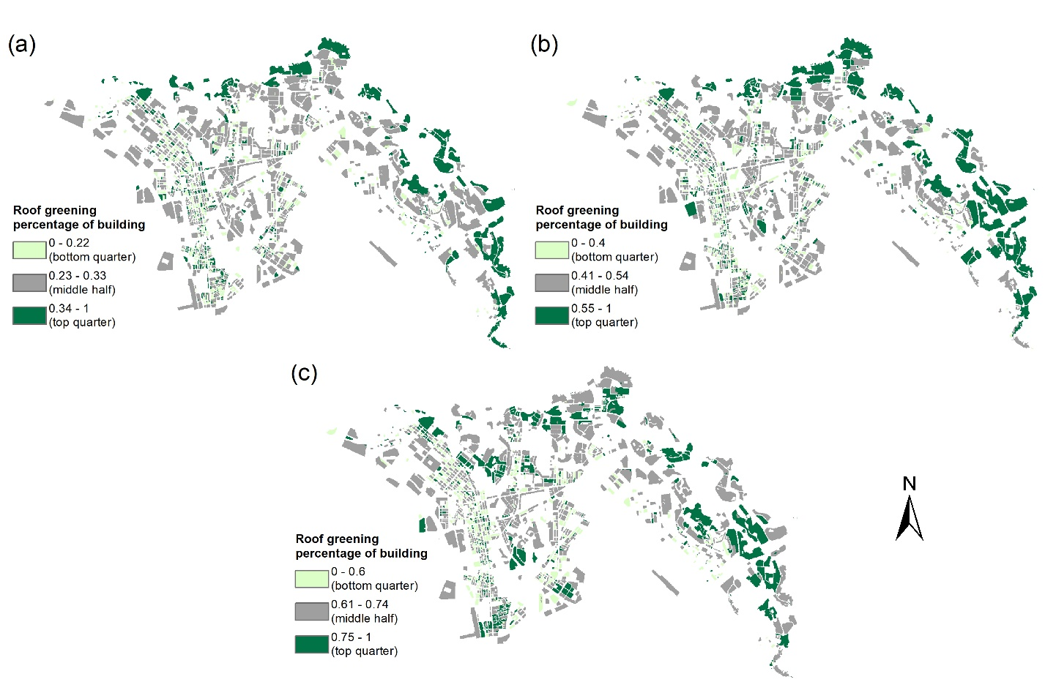
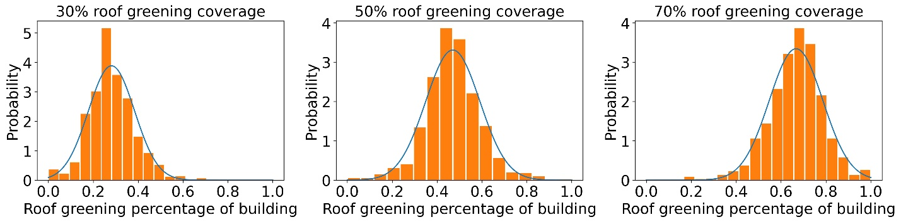

04. Result —— 1st Objective: To Maximize Mean Temperature Reduction
Roof greening proportions on buildings (=$\frac{Green roof area on a building}{Rooftop area of the building}$) follow a normal distribution
The top quarter (the prioritized areas) sprawls to the inner area as the total green roof target rises
Figure 6. Distributions of the proportion of greening over building roof to maximize the mean temperature reduction for the coverage targets of 30%, 50% and 70%.
Figure 7. Spatial distribution of the buildings with the proportion of greening in roof ranking the bottom quarter (light green), middle half (grey) and top quarter (dark green) for the coverage targets of 30% (a), 50% (b) and 70% (c) to maximize the mean air temperature reduction.
Notes:
This is the roof greening allocation pattern with the objective to maximize , I choose 30, 50, 70 to see the transition trend.
One finding is that the, which means the model transform different areas simultaneously instead of sequentially, but it does have a preference. The dark green roof proportions in the map indicates the top quarter roof percentage in each scenario. We can see the prioritized areas crawls from the boundary areas to peninsula, but the focus remains in the northern and eastern Kowloon, Kowloon tung and ngu tau kok even for 70%

Slide 12
04. Result —— 1st Objective: To Maximize Mean Temperature Reduction
Roof greening proportions on buildings (=$\frac{Green roof area on a building}{Rooftop area of the building}$) follow a normal distribution
The top quarter (the prioritized areas) sprawls to the inner area as the total green roof target rises
Figure 6. Distributions of the proportion of greening over building roof to maximize the mean temperature reduction for the coverage targets of 30%, 50% and 70%.
Figure 7. Spatial distribution of the buildings with the proportion of greening in roof ranking the bottom quarter (light green), middle half (grey) and top quarter (dark green) for the coverage targets of 30% (a), 50% (b) and 70% (c) to maximize the mean air temperature reduction.
Notes:
This is the roof greening allocation pattern with the objective to maximize , I choose 30, 50, 70 to see the transition trend.
One finding is that the, which means the model transform different areas simultaneously instead of sequentially, but it does have a preference. The dark green roof proportions in the map indicates the top quarter roof percentage in each scenario. We can see the prioritized areas crawls from the boundary areas to peninsula, but the focus remains in the northern and eastern Kowloon, Kowloon tung and ngu tau kok even for 70%

Slide 13
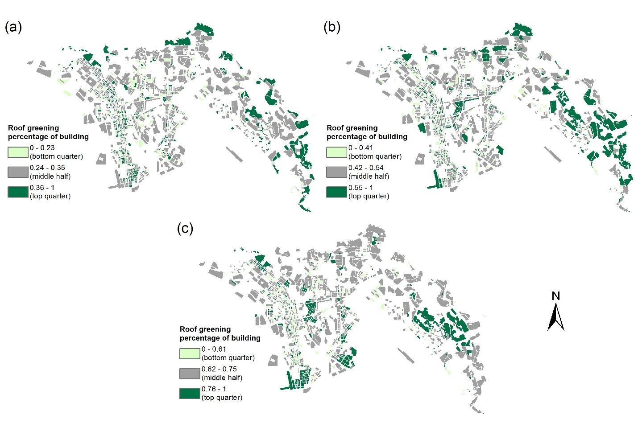
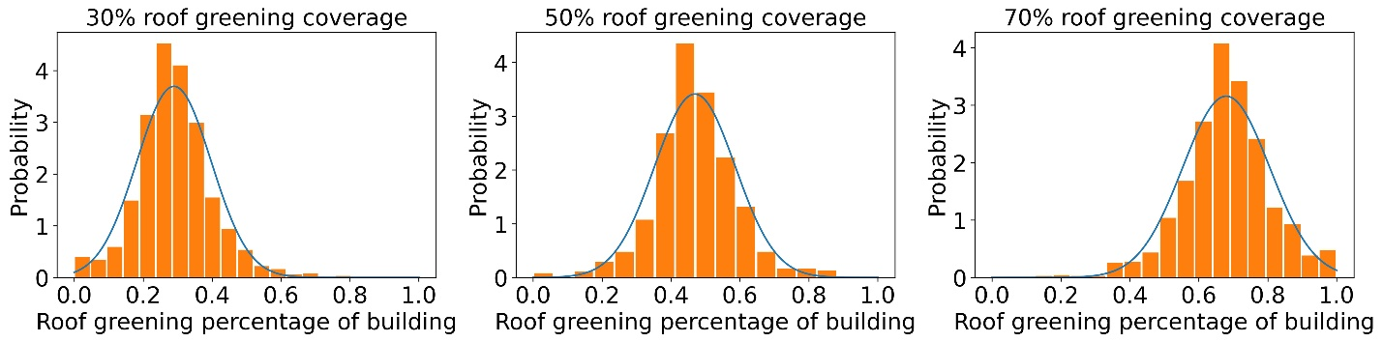
04. Result —— 2nd Objective: To Minimize Heat Exposure
The boundary area (near the forest) is less prioritized
The top quarter (the prioritized areas) is more aggregated while that of the 1st objective is more dispersed
Figure 8. Distributions of the proportion of greening over building roof to minimize the heat exposure for the coverage targets of 30%, 50% and 70%.
Figure 9. Spatial distribution of the buildings with the proportion of greening in roof ranking the bottom quarter (light green), middle half (grey) and top quarter (dark green) for the coverage targets of 30% (a), 50% (b) and 70% (c) to minimize the heat exposure.
Notes:
For the patterns with the objective to mini, the allocations still follow a normal distribution, but in this case, the prioritized roof crawls faster is less concentrated in the boundary areas for 70%. The Kowloon tung area is no longer prioritized, instead, the middle and bottom area are more aggregated with top quarter
As the trend of both objectives are from boundary to peninsula, but 70% pattern differ the most, we specifically compare these two scenarios to look for more insights

Slide 14
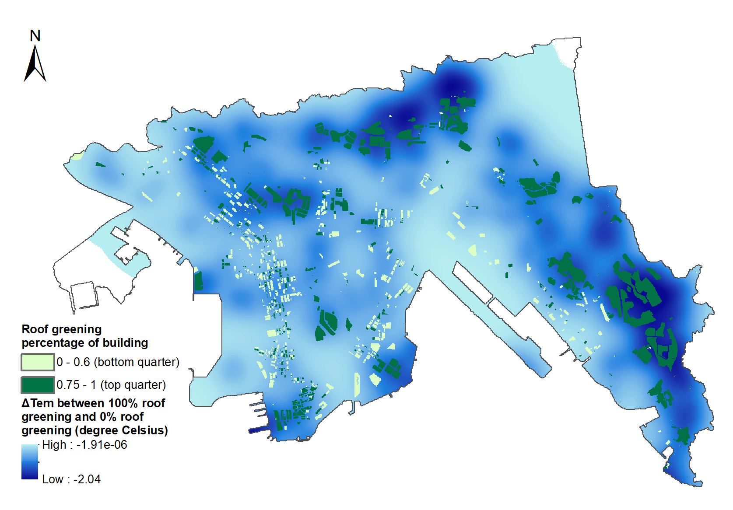
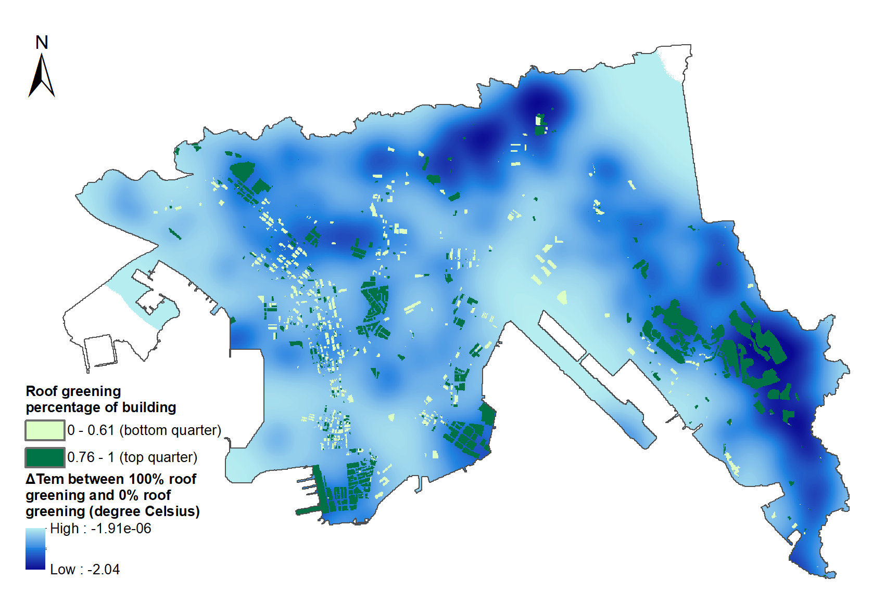
04. Result —— Comparison
(a)
(b)
Differences | Similarities
(a) To maximize the mean temperature reduction: Align with the areas of more cooling effect
Figure 10 & 11. The cooling potentials of buildings with the proportion of greening over building roof ranking the top quarter and bottom quarter in the 70% coverage target scenario to: a) maximize the mean air temperature reduction; and b) minimize the heat exposure
Notes:
To interpret the optimization decisions, the 70% scenarios with the two objectives are mapped to the temperature reduction map of 100% coverage of roof greening (Figure 8). For the maximize, It can be observed that the distribution of the prioritized buildings is dispersive but mostly in accordance with the regions having the high temperature reductions, suggesting that these regions are of large cooling potentials through roof greening. On the contrary, the minimize does not show the same pattern. The dark blue area in the north does not show prioritized buildings.

Slide 15
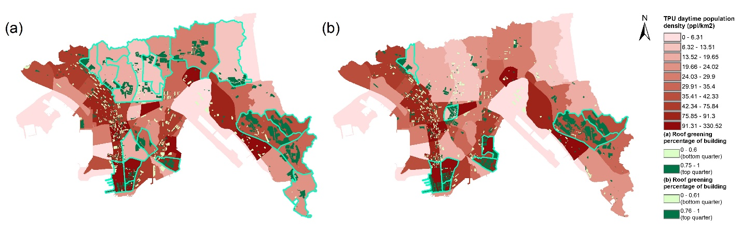
04. Result —— Comparison
Differences | Similarities
(a) To maximize the mean temperature reduction: Align with the areas of more cooling effect | Prioritized areas:
 | Ngau Tau Ko | Tsim Sha Tsui and Hung Hom
(b) To minimize heat exposure: No priority in northern Kowloon, gather in TPUs with or surrounded by dense populations | Overlooked area: Sham Shui Po to Yau Ma Tei
Figure 12. The population density map of Kowloon in the unit of TPU and the buildings with different proportions of greening over the roof in the 70% coverage target scenario to: a) maximize the mean air temperature reduction; and b) minimize the heat exposure
Notes:
The 70% scenarios are further mapped to population density map in the unit of TPU, territary planning unit. The redness indicate the population intensity. A notable feature to minimize heat exposure is that the prioritized buildings are concentrated within certain TPUs while those to maximize the mean air temperature reduction are dispersed across multiple TPUs. Prioritized buildings to minimize heat exposure are either of high population density or surrounded by population-dense areas. In contrast, prioritized buildings are located in the northern TPUs with low population density to maximize the mean air temperature reduction.
The common prioritized areas of the two objectives are
The commonly overlooked areas but with high pop density is

Slide 16
05. Discussion
Implications
The city should consider the threshold to set up its minimum roof greening coverage requirement to create more significant benefits.
Different objectives result in different planning solutions. Geographical inequalities of green infrastructure benefits could also arise especially for some population-dense areas.
Limitations
The UCM model is a much less compute-intensive model compared with traditional climate models. For higher reliability, some urban canopy parameters that affect the air mixing and cooling effect should be included.
The optimization does not provide a deterministic best solution due to the algorithm and absent of more factors to consider in real policy planning.
Notes:
The city should consider the threshold to set up its minimum roof greening coverage requirement so that the policy incentives to encourage additional investment in greening can create more significant benefits.
due to the low cooling potential with 100% roof greening coverage. When it comes to decide the future renewal strategies, The government may pay special attention to these areas and incorporate other gi that helps the cooling effect.
building height/road width
GA is a stochastic search based algorithm, it can provide a good enough with fast enough speed. Which means the general pattern is correct, but saying it’s the best solution for urban renewal and green roof implementation is not guaranteed. Plus, there are more factors to consider, such as the roof feasibility, social acceptance, cost etc.

Slide 17
Thanks for listening

Slide 18
Random roof allocations
10%-90% green roof
UCM evaluation
Two objectives
Yes
End
Converges after 200 generations
Selection
Crossover
Mutation
Offspring
Notes:
Large green spaces have a cooling effect on surrounding areas, synergistic effect

