Slide 1
Resilience and Sustainability: Understanding Interconnections for Better Planning and Policy Formulation
By Felix Fernando
University of Dayton- Hanley Sustainability Institute

Slide 2
Presentation Outline
Background
Resilience and Sustainability
Theoretical framework and methodology
Findings
Policy Implications

Slide 3
The University of Dayton
Founded in 1850 by the Society of Mary
Private, Catholic, Marianist university
University for the Common Good
Top-20 ranking as one of Sierra’s ‘cool schools’
The University also has a gold STARS rating from AASHE
President Eric F. Spina signed Second Nature's Resilience Commitment in 2019
Focused on climate adaptation and community-building to address a changing climate and resulting extremes
UD is the only Ohio college or university part of Second Nature's carbon and resilience commitments

Slide 4
Resilience Planning Aims
Resilience planning at University of Dayton represents one of the first efforts to expand beyond a university’s campus and address the issues in an aging rust belt city.
The aims of the project are:
(a) Conduct an assessment of the threats and vulnerabilities faced by the City of Dayton community
(b) Examine the role of the University in building resilience capacity and support strategies for the broader community
(c) Create a plan that adopts best practices and sustainable solutions as a pathway to build resilience capacity.

Slide 5
Resilience and Sustainability
Resilience is the ability of a system or community to survive disruption and to anticipate, adapt, and flourish in the face of change (Second Nature)
Largely focused on adaptation
We live in a world impacted by climate change; adaptation alone is not adequate
Certain sustainable solutions such as renewable energy micro-grids, green urban infrastructure, and carbon sequestration through urban farming can help to build local resilience while also advancing sustainability initiatives
Solutions that builds resilience, advances sustainability, empowers communities, and protects most vulnerable members
Sustainable solutions need to be considered as pathways for building local resiliency

Slide 6
Theoretical Framework and Methodology
The University exists within the community
Extreme weather events and climate risks
Other risks and vulnerabilities
Immediate surrounding neighborhoods
Socio-economic dynamics
Most vulnerable are the most impacted
Ways that University could contribute
City of Dayton
Bigger geographic footprint
Mid-size rust belt city
Need to combine and integrate a variety of data

Slide 7
Theoretical Framework and Methodology
Three frameworks
Second Nature planning and implementation framework
100 Resilience Cities
Community Capitals Framework
Methods
Secondary data and documentary analysis- Shocks, stresses, and vulnerabilities
GIS data and mapping
Focus groups and interviews- University and community
Key stakeholders and multiple chains
Possible planned survey

Slide 8
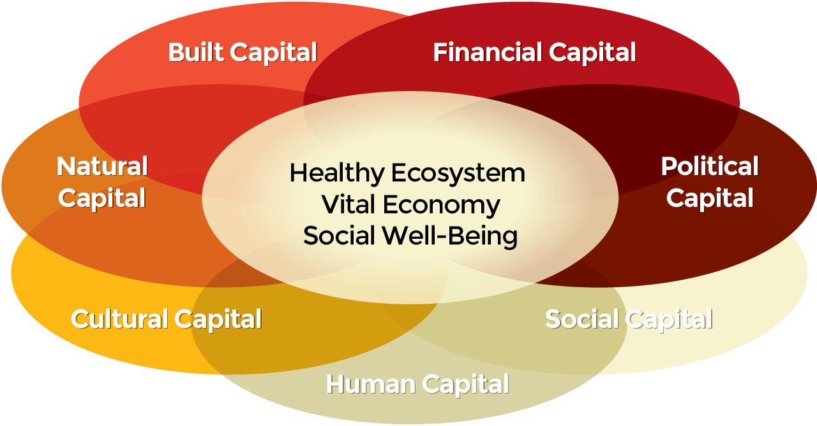
A Holistic Planning Framework
Second Nature
Campuses build, track, and report on resilience in the five categories
100 Resilient Cities
Five key innovations
Understanding Risks and Assets Holistically
Mapping Existing Actions and Perceptions
Investing in Exploratory Work and Filling Knowledge Gaps
Selecting Resilience Initiatives
Creating a Compelling Resilience Narrative
Five key focuses
1. Incorporate systems thinking into their decision-making, taking into account shocks and stresses, and maximizing co-benefits.
2. Engage with diverse stakeholder communities in the planning process.
3. Integrate projects within a broader community vision that includes vulnerable populations.
4. Assess and build projects based on the long-term environmental, social, and economic benefits they will bring, as well as their ability to withstand short-term disruptions.
5. Recognize that their infrastructure and other systems will need to adapt to new and unforeseen challenges in the future
Community Capitals Framework: Jan and Cornelia Flora
Capital/asset based development

Slide 9
Resilience Perspectives of Public Officials
Recover from disasters or dramatic change
Largely focused on emergency planning and disaster recovery
Ability to bounce back from shocks (acute and chronic)
Short term focused
Minimizing damages and restoring status-quo as soon as possible
Hardening infrastructure, anticipating potential damages, and recovering
Securing resources necessary for preparing and responding
Key focus areas
Resident health and safety
Infrastructure (bridges, roads, water systems, energy systems)
Public services
Buildings
Focus is not eliminating or reducing the magnitude of disasters, but recovery from such (reactive rather than proactive)

Slide 10
Resilience Perspectives of Community
Perspectives around disaster recovery and bouncing back better
More broadly defined around community needs such as
Food security
Infrastructure vulnerability (road systems, water systems, and energy systems)
Housing affordability
Social equity
Sense of community (knowing and helping each other, integrating new residents)
Maintaining “what we love about our community in the face of change”
Recognizing what is good or positive about the community and trying to turn what is negative about the community into positive
Supporting vulnerable residents in the neighborhood such as the elderly and the poor

Slide 11
Sustainability Perspectives of Public Officials
Leveraging assets that can provide services to meet community needs now and into the future
Infrastructure assets such as roads and bridges, replacing them in future
Protecting certain environments, habitats, and minimizing ,carbon footprint of their services
Largely focused around environmental goals: renewable energy, transportation, land-use planning, infill development
Ensuring financial viability and availability to maintain community services and assets

Slide 12
Sustainability Perspectives of Community
Understanding the “new normal” within the context of climate change and implications for community
Resources needed to satisfy community needs on a day to day basis
Food, water, energy, health, communication
Sense of community
Capacity of processes and systems that satisfy community needs on a day to day basis
Food supply systems, water systems, energy systems
Maintaining these systems and reconfiguring them to better suit the needs of the community

Slide 13
Interconnections Between Resilience and Sustainability
Sustainable development as a process that would also build resilience
Renewable energy microgrids or portable solar power stations can advance sustainability and build resilience
Local food systems can reduce carbon footprint and increase food security
Alternative transportation such as bike routes can provide access if roads are blocked and can provide biking options for community
Plans are connected such that climate action (such as reducing greenhouse gas emissions) need to be part of resilience plans
Certain environments such as wetlands, waterways, forests could contribute to both: sequester carbon and help address certain weather events.

Slide 14
Policy Implications
Lack of understanding about causes of climate change (such as greenhouse gases) as a driver of specific climate disaster events, especially among the political leadership, has created a disconnect between action
Differing resilience perspectives between community and public officials
Similarities on recovering from disasters and shocks
Public officials: Preparing and recovering from specific events that impact community
Community: More broadly around maintaining systems and processes that meet community needs
Short-term action is easy to accomplish compared to long-term incremental visions
Resilience focused on disaster recovery rather than around building long-term capacity
Smaller cities do not have resources to address broader community needs
Climate action planning such as reduction in greenhouse gas emissions are largely focused on city departments rather than whole community

Slide 15
Thank you! Questions!
Felix Fernando: wfernando1@udayton.edu

